Slide 1
Pricing by The Bino-trinomial Tree 穩操勝算(看多型)─中壽
NCTU FinLab

Slide 2
Outline
Product Information-Parameter
Product Information-Computing Rule
Adopted Model
Pricing Program

Slide 3
Product Information-Parameter
This product connect with 中壽(2823),Par issue.
Capitial:1,000,000
Contract price:1,000,000
Terms:35 days
Initial Stock Price(So):$17
Exercise Price(H):So x 100%=$17
Low Bound Price(L):So x 84%=$14.28
Start date:2009/6/2
Observation Date:
1:2009/6/9, 2:2009/6/16, 3:2009/6/23 4:2009/6/30
End date:2009/7/7
Balance Price: Closed Price of end date
These all are Tuesday.

Slide 4
Product Information- Computing Rule
Start Date
End Date
H:$17
L:$14.28
Excise Price(H)=Initial Open Price=17
Earn 1,000,000*(1+0.12*2)
Earn 1,000,000*(1+0.12*1)
If Price>=H(17),it will be early exercised. Earning: Capital*(1+0.12*j) j:Ob Date#
If St>=H(17): [St: Close price of end date]
Earning: Capital*(1+0.06)
If price always go above B(14.28), and St between H and L: Earning: Capital*(1+0.06)
Otherwise:
Earning: Capital*(St/K)
Ob Date 1
Ob Date 2
Ob Date 3
Ob Date 4

Slide 5
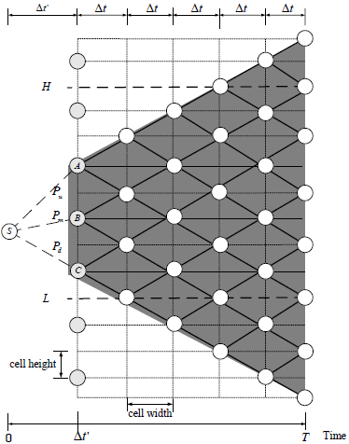
Adopted Model
“Although the option prices computed by a tree model converge to the theoretical value as the number of time steps increases, the distribution error and the nonlinearity error may make the prices converge slowly or even oscillate significantly.”, reference from “The Bino-trinomial Tree a Simple Model”.
The Bino-trinomial Tree, Tian-Shyr Dai and Yuh-Dauh Lyuu.
The bBTT Mode

Slide 6
Pricing Program – Overall View
class BttModel
main()
include
1.Building BttModel objects
=>5 BttModel objects
2.Backward inducation
Input(detecting)
Count trascation days(use QuantLib)
Control BttModel objects
Output

Slide 7
Pricing Program - include
#include "stdafx.h"
#include <cmath>
#include <iostream>
#include <ql/qldefines.hpp>
#include <ql/version.hpp>
#ifdef BOOST_MSVC
# include <ql/auto_link.hpp>
#endif
#include <ql/time/all.hpp>
using namespace std;
using namespace QuantLib;
int const SIZE=1000; //Arrary size
Include QuantLib

Slide 8
Pricing Program - BttModel
class BttModel{
public:
static const int ALL=0,PRICE=0,NON=0,FIN=1,NUM=1,NOW=1,HIT=2; //codes for replace number
static int bttNum,captial; //the total number of BTT objects and the captical
int finNum,m,no; //the number of nodes(prices) in the final term, term, and the order number of BTT objects
/* 1.when we build BTT Model: s[ALL][x]:all the created prices by BTT, s[FIN][x]:the prices in the final term only
2.when we execute backward induction: s[NON][x]:the value without hit,s[NOW][x]:the price now,s[HIT][x]:the value with hit */
float s[3][SIZE];
float hPrice,lPrice,exePrice,sigma; //bound price(high price,low price), exercise price, and volatility of stock price
float deltaTP,deltaT; //the interval in the first term, and the interval in every term after first one in BTT model
/*iniInf[PRICE]:the first price under the hight price in first term
iniInf[NUM]:the total numbers of prices under hprice without bound in first term
finInf[PRICE]:the first price under the hight price in final term
finInf[NUM]:the total numbers of prices under hprice without bound in final term
they can helps for connect next BTT object*/
float iniInf[2],finInf[2];
float pu,pm,pd; //the branching probabilities in first term
float crrPu,crrPd; //the branching probabilities after first term (The part of CRR Tree)

Slide 9
Pricing Program - BttModel
/*set and computee BTT parameters
hp:high price, bp:low price, ep:exercise price, *iniNode:the finInterInf[] of the preceding BTT, t:years of period, tempM:the temporary term, sig:volatility of stock price, r:year rate*/
void set(float hp,float bp,float ep,float *iniNode,float t,float tempM,float sig,float r){}
/* backward inducation
value[x][NON]:values without hit low bound among bounds in final term
value[x][HIT]:values had been hited low bound among bounds in final term*/
void calculate(float value[][2]){}
};
//initiate static member
int BttModel::bttNum=0,BttModel::captial=0;

Slide 10
Pricing Program – main()
int _tmain(int argc, _TCHAR* argv[])
{
int const YEAR=0,MONTH=1,DAY=2; //just codes
/* iniPrice:initial price, exePrice:excercise price, r:year rate, sigma:volatility of stock price
hPrice:high price, lPrice:low price */
float iniPrice,exePrice,r,sigma,hPrice,lPrice,t=0;
int captial,m,obNum; //captical, term, and number of observation dates
int obDate[SIZE][3];//observation date; obDate[x][YEAR]:year, obDate[x][MONTH]:month, obDate[x][DAY]:day
float obDays[SIZE]; //intervals among observation dates
float tDays=250; //the transaction days in Taiwan
bool isTest=true;
char flag;
cout<<"Test Mode?(y/n)";
cin>>flag;
if(flag=='n' || flag=='N') isTest=false;

Slide 11
Pricing Program – main()
if(isTest){
//use default data
captial=1000000;
iniPrice=exePrice=hPrice=17;
lPrice=iniPrice*.84;
obDate[0][0]=2009;
obDate[0][MONTH]=6;
obDate[0][DAY]=2;
obDate[1][YEAR]=2009;
obDate[1][MONTH]=6;
obDate[1][DAY]=9;
obDate[2][YEAR]=2009;
obDate[2][MONTH]=6;
obDate[2][DAY]=16;
obDate[3][YEAR]=2009;
obDate[3][MONTH]=6;
obDate[3][DAY]=23;
obDate[4][YEAR]=2009;
obDate[4][MONTH]=6;
obDate[4][DAY]=30;
obDate[5][YEAR]=2009;
obDate[5][MONTH]=7;
obDate[5][DAY]=7;
obNum=5; //note:the obDate[0], start date, is not counted
r=1.005; //one-year floating rate was published by The Taiwan Bank at 2009
sigma=0.9; //the stock volatility of stock of 中壽between 6/2 and 7/7 at 2009
m=80;
}else{…}

Slide 12
Pricing Program – main()
/* count years of the transcation days */
int i;
Calendar myCal=Taiwan(); //QuantLib class
Date *date1,*date2;
enum Month mon;
for(i=0;i<obNum;i++){
mon=Month(obDate[i][MONTH]); //because the parameters must be the type of "enum", we tranform the integral to enum
date1=new Date(obDate[i][DAY],mon,obDate[i][YEAR]);
mon=Month(obDate[i+1][MONTH]);
date2=new Date(obDate[i+1][DAY],mon,obDate[i+1][YEAR]);
obDays[i]=myCal.businessDaysBetween(*date1,*date2)/tDays; //comput the days among adjacent observation days
t+=obDays[i];
}
BttModel *btt=new BttModel[obNum]; //build all BTT objects
BttModel::captial=captial; //set the captial of BTT

Slide 13
Pricing Program – main()
/* initiate the first BTT object */
float ini[]={iniPrice,1}; //record the start price
btt[0].set(hPrice,lPrice,exePrice,ini,obDays[0],obDays[0]/t*m,sigma,r);
/* initiate remaining BTT objects */
for(i=1;i<obNum;i++)
btt[i].set(hPrice,lPrice,exePrice,btt[i-1].finInf,obDays[i],obDays[i]/t*m,sigma,r);
/* backward induction */
float value[1000][2]={0}; //record the values in first term
for(i=obNum-1;i>=0;i--){
btt[i].calculate(value);
}
Term

Slide 14

Pricing Program – BttModel
void set(float hp,float bp,float ep,float *iniNode,float t,float tempM,float sigma,float r){
hPrice=hp; lPrice=bp; exePrice=ep;
sigma=sig;
iniInf[PRICE]=iniNode[PRICE];
iniInf[NUM]=iniNode[NUM];
/* find the adjusted parameter k, which is the intergral interval among log bound prices */
float h=log(hPrice/iniNode[PRICE]),l=log(lPrice/iniNode[PRICE]); //compute log price
float deltaTau=t/tempM;
int k=ceil((h-l)/(2*sigma*pow(deltaTau,0.5F)));
/* compute the suitable parameters by k, so the bound prices can be reach by tree node */
deltaT=pow((h-l)/(2*k*sigma),2);
deltaTP=t-(floor(t/deltaT)-1)*deltaT;
m=floor(t/deltaT); //the new term
/* find the log price B, which is closest to μ(Δt') */
int i;
float muTP=(r-pow(sigma,2)/2)*deltaTP; //μ(Δt')
float diff=9999999999; //record the shortest interval
float b,temp;
for(i=0;i<=2*k;i=i+2){ //serch the prices between h and l in first term
//if it's even, the prices in first term will be different to ones, which without bound price, in final term
if(i==0 && m%2==0)
i=1;
temp=l+i*sigma*pow(deltaT,0.5F); //get every prices, by low price, in first term
if(abs(temp-muTP)<diff){ //compare with other intervals
b=temp;
diff=abs(temp-muTP);
}
}
even
K=4
μ(Δt')
2K+1
Even: i=1,3,5,7,…
Odd: i=0,2,4,6,…

Slide 15
Pricing Program
M=6
M+1
/* record all prices in BTT */
//the number of total created prices by BTT(if number of initial nodes more than one, added to the tolNum)
int tolNum=2*m+3+(iniNode[NUM]-1)*2;
int index=m+1; //the number of intervals between B and the highest log price
for(i=0;i<tolNum;i++){
//compute the log prices and restore them by take exponential
s[ALL][i]=exp(b+index*sigma*pow(deltaT,0.5F))*iniNode[PRICE];
index--;
}
/* record all prices in final term */
index=m+1; //restore the number
finNum=0; //record the number of prices in final term
finInf[NUM]=0; //record the number of prices, which is under high price, in final term
for(i=0;i<ceil(tolNum/2.0);i++){
s[FIN][i]=exp(b+index*sigma*pow(deltaT,0.5F))*iniNode[PRICE];
index=index-2;
finNum++;
if(s[FIN][i]<hPrice)
finInf[NUM]++;
}
M-1
2
0
(M+1)*2+1=2M+3

Slide 16
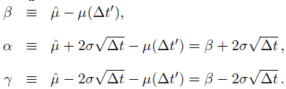
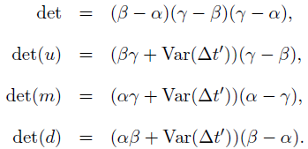
Pricing Program
/* find the branching probabilities in first term*/
float beta=b-muTP,alpha=beta+2*sigma*pow(deltaT,0.5F),gamma=beta-2*sigma*pow(deltaT,0.5F);
float varTP=pow(sigma,2)*deltaTP;
float det=(beta-alpha)*(gamma-alpha)*(gamma-beta);
float detU=(beta*gamma+varTP)*(gamma-beta);
float detM=(alpha*gamma+varTP)*(alpha-gamma);
float detD=(alpha*beta+varTP)*(beta-alpha);
pu=detU/det,pm=detM/det, pd=detD/det;
/* find the branching probabilities after first term*/
float crrU=exp(sigma*pow(deltaT,0.5F)),crrD=exp(-1*sigma*pow(deltaT,0.5F));
crrPu=(exp(r*deltaT)-crrD)/(crrU-crrD);
crrPd=1-crrPu;
/* find the information among bounds in final term */
if(finInf[NUM]>0)
finInf[PRICE]=exp(h-2*sigma*pow(deltaT,0.5F))*iniNode[PRICE];
}

Slide 17
Pricing Program – main()
/* initiate the first BTT object */
float ini[]={iniPrice,1}; //record the start price
btt[0].set(hPrice,lPrice,exePrice,ini,obDays[0],obDays[0]/t*m,sigma,r);
/* initiate remaining BTT objects */
for(i=1;i<obNum;i++)
btt[i].set(hPrice,lPrice,exePrice,btt[i-1].finInf,obDays[i],obDays[i]/t*m,sigma,r);
/* backward induction */
float value[1000][2]={0}; //record the values in first term
for(i=obNum-1;i>=0;i--){
btt[i].calculate(value);
}

Slide 18
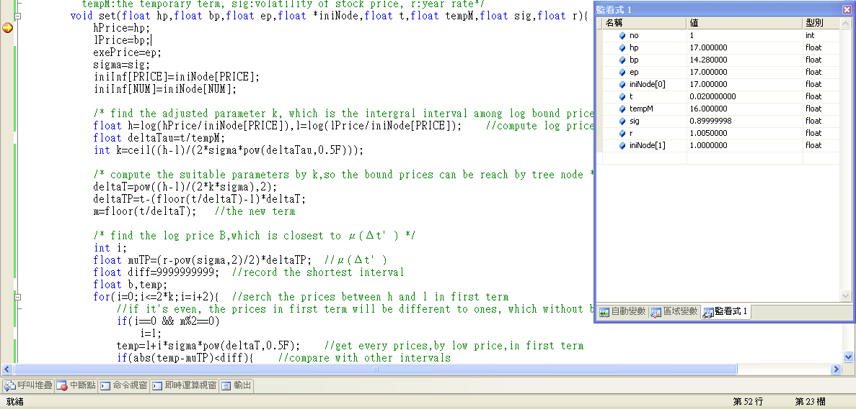
Pricing Program – Demo

Slide 19
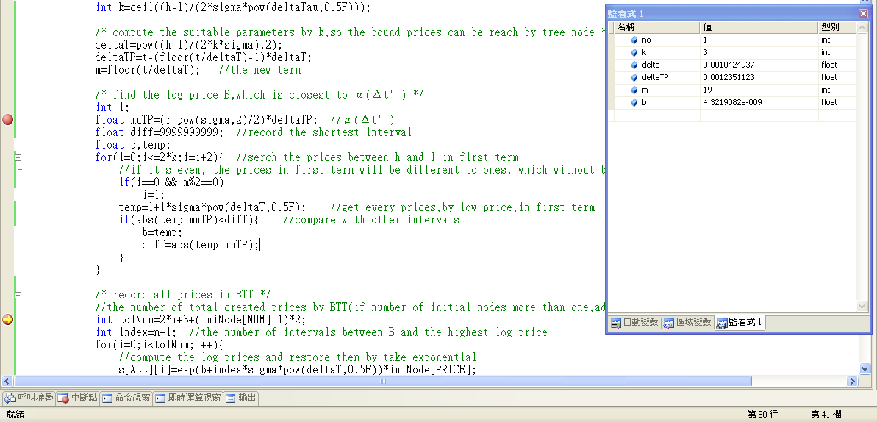
Pricing Program – Demo

Slide 20
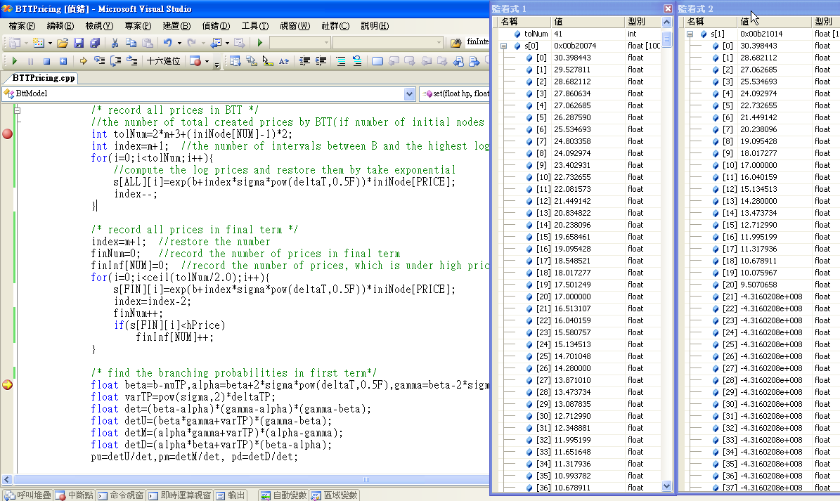
Pricing Program – Demo
S[ALL][x]
S[FIN][x]

Slide 21
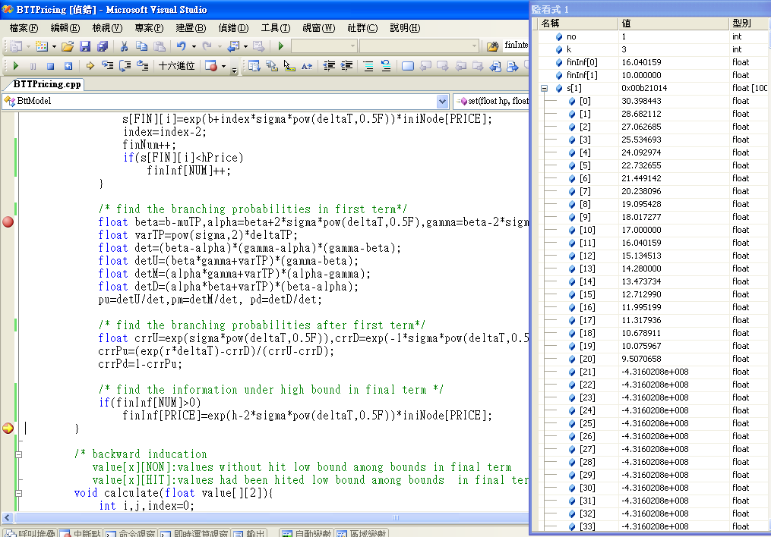
Pricing Program – Demo

Slide 22
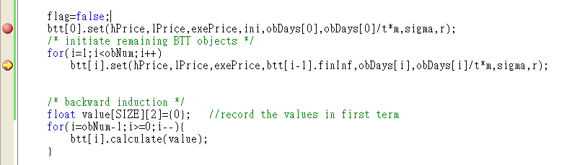
Pricing Program – Demo

Slide 23
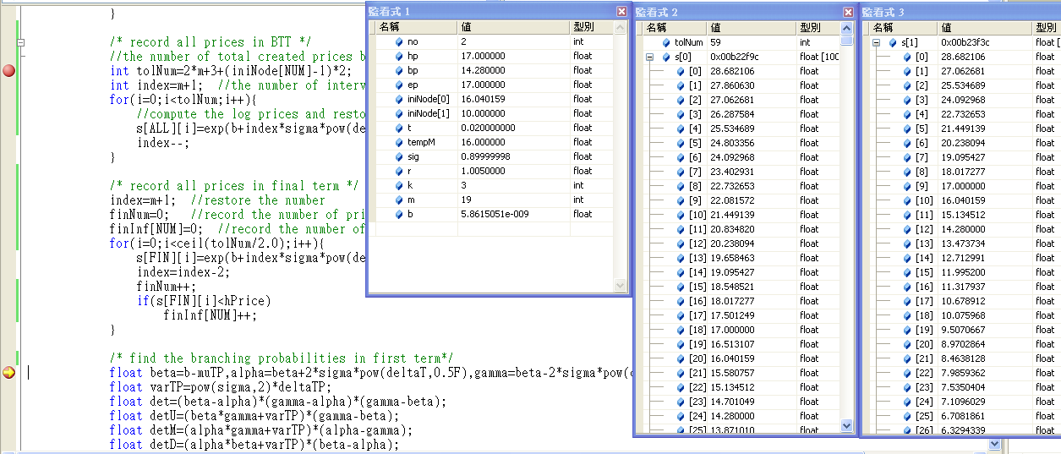
Pricing Program – Demo
S[ALL][x]
S[FIN][x]
16.040159
10
term1
term2

Slide 24
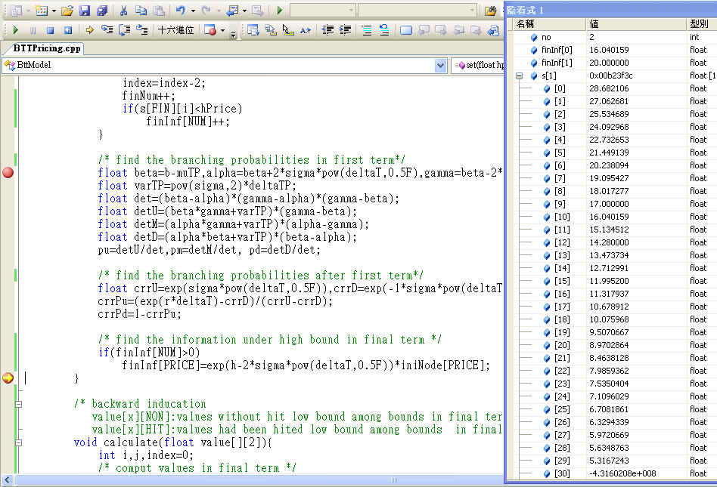
Pricing Program – Demo

Slide 25
Pricing Program – Demo
/* initiate the first BTT object */
float ini[]={iniPrice,1}; //record the start price
btt[0].set(hPrice,lPrice,exePrice,ini,obDays[0],obDays[0]/t*m,sigma,r);
/* initiate remaining BTT objects */
for(i=1;i<obNum;i++)
btt[i].set(hPrice,lPrice,exePrice,btt[i-1].finInf,obDays[i],obDays[i]/t*m,sigma,r);
/* backward induction */
float value[1000][2]={0}; //record the values in first term
for(i=obNum-1;i>=0;i--){
btt[i].calculate(value);
}
value[][NON],value[][HIT]
Updated value[][]
btt[i]
btt[i+1]

Slide 26
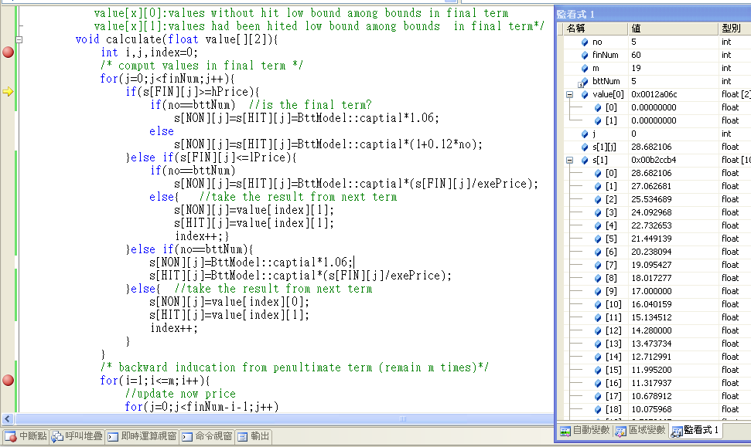
Pricing Program – Demo

Slide 27
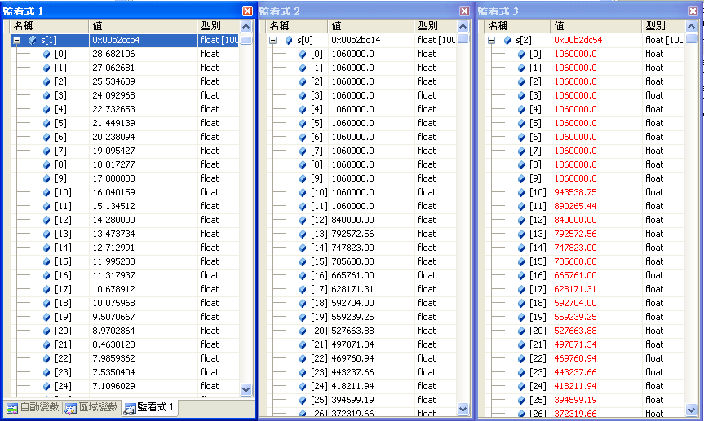
Pricing Program – Demo
S[NOW][]
S[NON][]
S[HIT][]

Slide 28
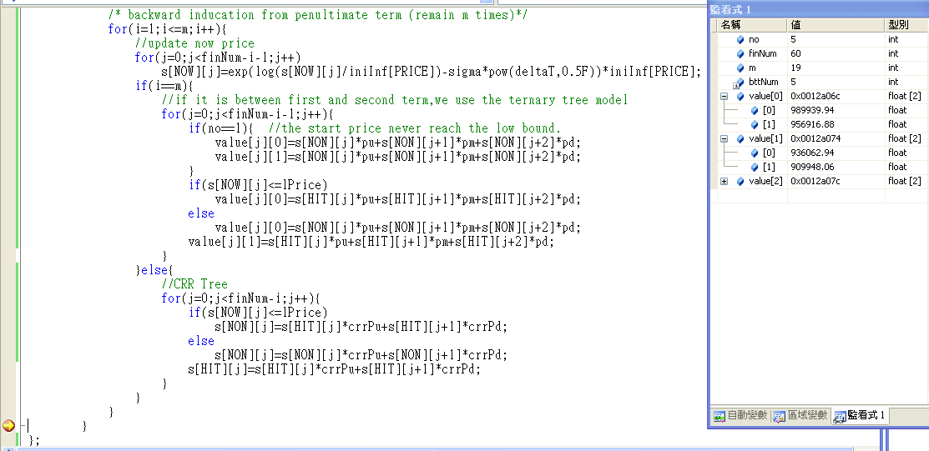
Pricing Program – Demo
M,m-1,…,
2 1 (i)

Slide 29
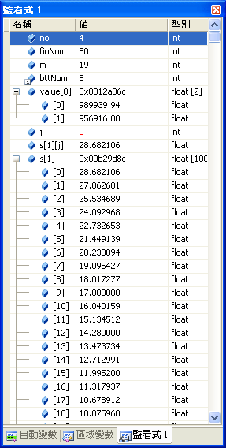
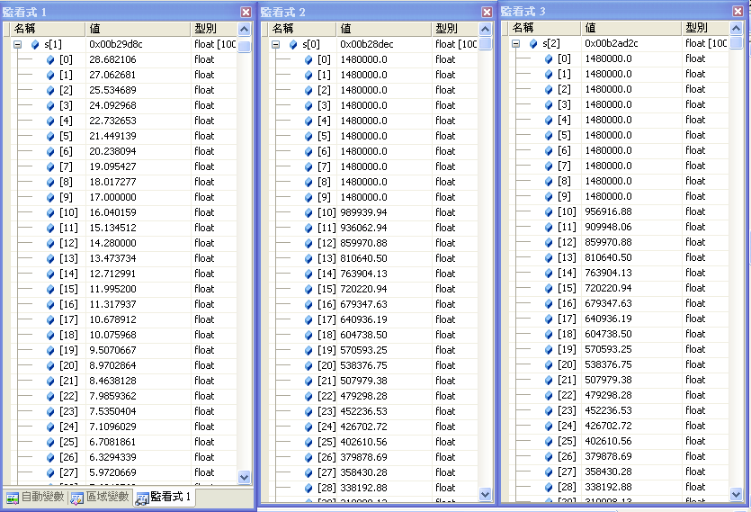
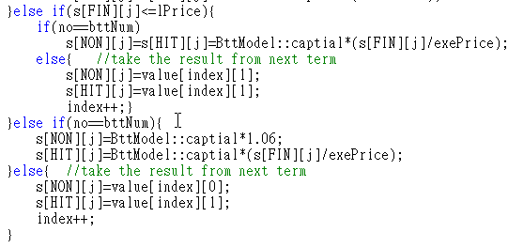
Pricing Program – Demo
S[NOW][]
S[NON][]
S[HIT][]

Slide 30
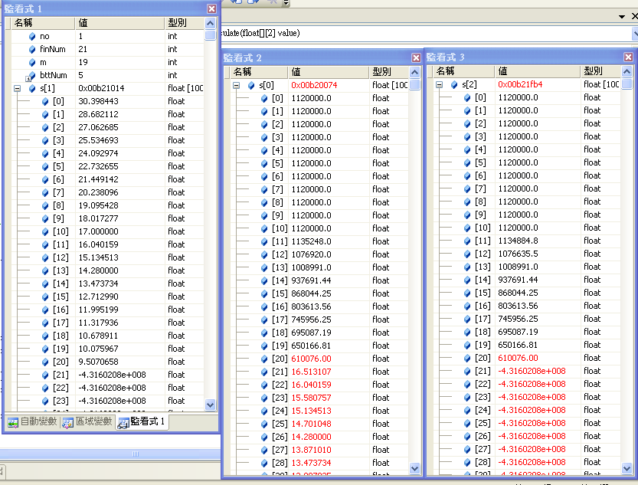
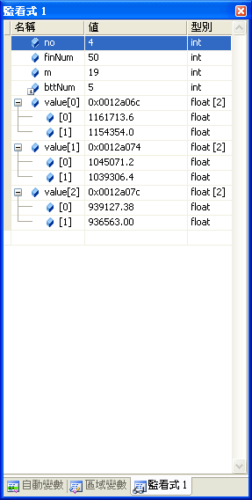
Pricing Program – Demo
S[NOW][]
S[NON][]
S[HIT][]

Slide 31
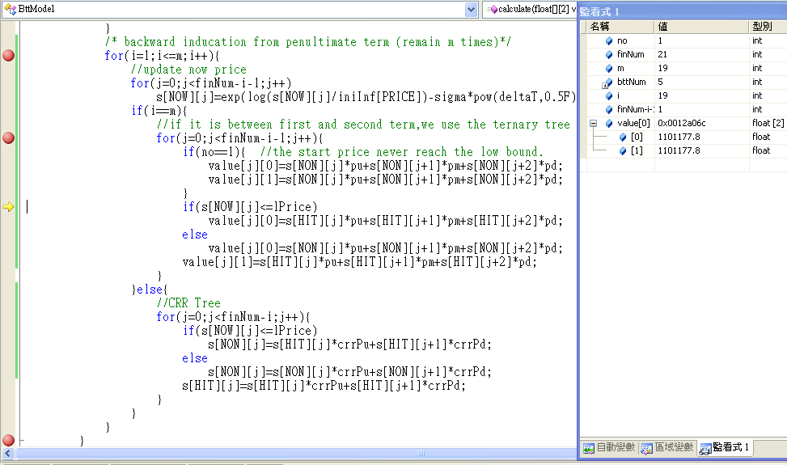
Pricing Program – Demo
i=m
2 1

Slide 32
Pricing Program – main()
cout<<endl<<"==========Result=========="<<endl;
cout<<"Captical:"<<captial<<endl;
cout<<"Initial stock price:"<<iniPrice<<endl;
cout<<"Exercise price:"<<exePrice<<endl;
cout<<"Hight bound price:"<<hPrice<<endl;
cout<<"Low bound price:"<<lPrice<<endl;
cout<<"Year rate:"<<r<<endl;
cout<<"Sigma:"<<sigma<<endl;
cout<<"term:"<<m<<endl;
cout<<"Start date:"<<obDate[0][YEAR]<<"/"<<obDate[0][MONTH]<<"/"<<obDate[0][DAY]<<endl;
for(i=1;i<obNum;i++)
cout<<"Observation date <<i<<":"<<obDate[i][YEAR]<<"/"<<obDate[i][MONTH]<<"/“
<<obDate[i][DAY]<<endl;
cout<<"End date:"<<obDate[obNum][YEAR]<<"/"<<obDate[obNum][MONTH]<<"/"<<obDate[obNum][DAY]<<endl;
cout<<"Princing Result："<<value[0][0]/exp(r*t)<<endl; //discount the value
cout<<"=========================="<<endl;
system("pause");
return 0;
}

Slide 33
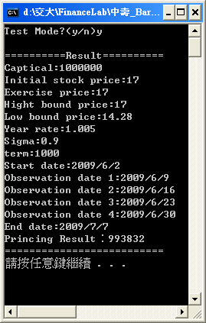



Result

Slide 34
Thanks for your listen
End

